Slide 1

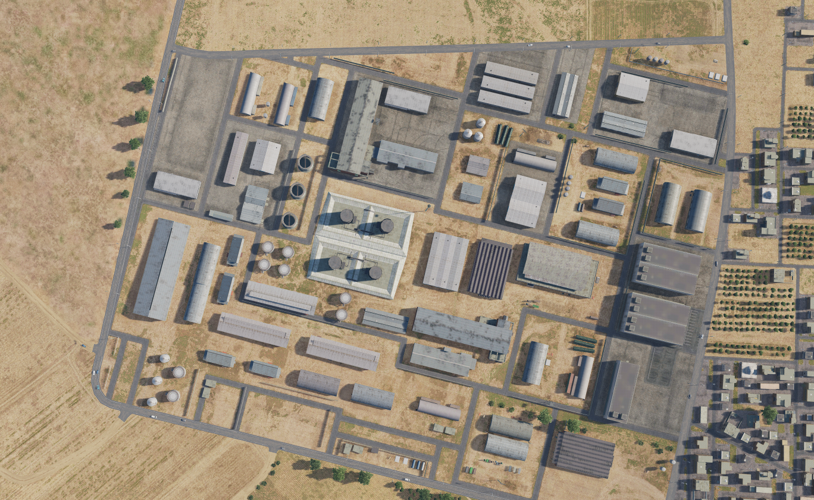
SYTGT137 South Aleppo Rocket Fuel Factory
SYTGT137
137
N
Target complex consist of a production building, a storage building, 3 tanks for storing UDMH (Fuel) and 2 tanks for storing IRFNA (Oxidiser).
Target likely protected by Syrian Armed defenses in place in Aleppo to protect.
VID assess no organic self-defense at this location.
Potential collateral concern by engaging IRFNA and UDMH.
4
5
6
Residential areas approx. 500m east and 750m northwest. Civilian industrial buildings in immediate vicinity. IRFNA and UDMH both very dangerous.
7
8

Slide 2
SYTGT137 South Aleppo Rocket Fuel Factory
SYTGT137A-G
N
137
DESCRIPTION OF THE DESIRED POINTS OF IMPACT WITH WPN TYPE:
SYTGT137A – Production Building
N36 09.381 E037 06.600 /XXXXft / (1x1000 Ibs bomb)
SYTGT137B – Storage building
N36 09.332 E037 06.625 / XXXXft / (1x2000 Ibs bomb)
SYTGT137C – UDMH (Fuel) Tank
N36 09.332 E037 06.606 / XXXXft / (2x2000 Ibs bomb)
SYTGT137D– UDMH (Fuel) Tank
N36 09.320 E037 06.601 /XXXXft / (2x2000 Ibs bomb)
SYTGT137E – UDMH (Fuel) Tank
N36 09.308 E037 06.598 / XXXXft / (2x2000 Ibs bomb)
SYTGT137F – IRFNA (Oxidiser) Tank
N36 09.325 E037 06.616 / XXXXft / (500 Ibs bomb)
SYTGT137G – IRFNA (Oxidiser) Tank
N36 09.312 E037 06.612 / XXXXft / (500 Ibs bomb)
A
B
C
F
D
E
G
4
5
- Elevation unknown, so only BOT attacks with a positive identification of target approved.
- UDMH tanks are protected tanks that make destruction very hard.
- Storage building also assessed as reinforced requiring 2000 Ibs bomb for destruction
6
7
8

